Slide 1

UniForum
A Course-Based Community Forum & Collaboration Platform
Payal • Vigneshwar • Vimala

Slide 2
The Academic Gap
Problem Statement
University students lack a centralized platform to:
The Solution: UniForum
•
Discuss course-specific topics and clearing doubts.
A Reddit-style forum specifically designed for university courses, integrating discussion, resource sharing, and meeting scheduling into one desktop application.
•
Collaborate on shared technical issues.
•
Efficiently schedule study sessions.
Target Users
University students

Slide 3
Analysis
Study
Research
Limited TA support
Scattered platforms
Repeated issues
Hesitation to ask simple queries
Reviewed existing platforms like Teams, Slack, Reddit, and Discord.
Analyzed pain points
Identified gaps in features like course-specific spaces, peer scheduling.
Designed integrations inspired by real usage patterns structured communities, peer help sessions, and a unified post-and-reply system.

Slide 4





Key Features
Course Communities
Reddit-Style Forum
Google Integration
Students join communities relevant to their enrollment. Similar to subscribing a channel.
Card-based post display with upvoting logic, nested recursive replies, and tag-based filtering.
OAuth 2.0 integration with Google Calendar API for scheduling Google Meet sessions directly from the application.

Slide 5

Design: Technical Architecture
Package Structure
MVC Pattern
edu.northeastern.uniforum
The application follows a strict Model-View-Controller design:
.controller (Logic)
•
View: Separation of UI from business logic includes FXML files + CSS.
.model (Data)
•
Controller: For handling user interactions and Coordinate between View and Model
.dao (Database Access)
•
Model: Business logic
.view (FXML UI)
•
DAO: Database abstraction

Slide 6




Design: User Process Flow
Authentication
Discovery
Collaboration
Action
Register & Secure Login
(Bcrypt Hashing)
Select Dept & Course
(Auto-join Community)
Create Posts,
Vote, & Reply
Schedule Meeting
(Google Meet API)

Slide 7

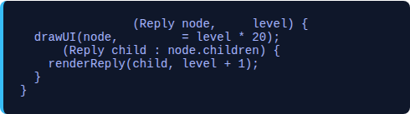
Algorithms & Logic
2. Sorting & Filtering
1. Recursive Reply Rendering
Sort and Filter posts by keyword, community, tag, and sort criteria
.based on upvotes and time of post creation. Apart from in memory, also have SQL order by
Renders nested "threaded" comments using N-ary tree traversal.
void
renderReply
int
padding
3. Security (Bcrypt)
for
Uses adaptive hashing with salt to protect passwords against rainbow table attacks.

Slide 8






Database Design (SQLite)
Users
Posts
Replies
PK: user_id
PK: post_id
PK: reply_id
user_name (Unique)
FK: user_id
FK: post_id
password_hash (Bcrypt)
FK: community_id
FK: parent_reply_id
department
title, content
content
vote_count
Communities
Post_Votes
User_Communities
PK: community_id
PK: vote_id
PK: composite
community_name
FK: post_id, user_id
FK: user_id
vote_type (+1/-1)
FK: community_id

Slide 9




Implementation
Core
Data
Integrations
Java 25
JavaFX 25.0.1 (UI)
SQLite (Embedded DB)
JDBC with Connection Pooling
Bcrypt for Security
Google Calendar API v3
OAuth 2.0

Slide 10
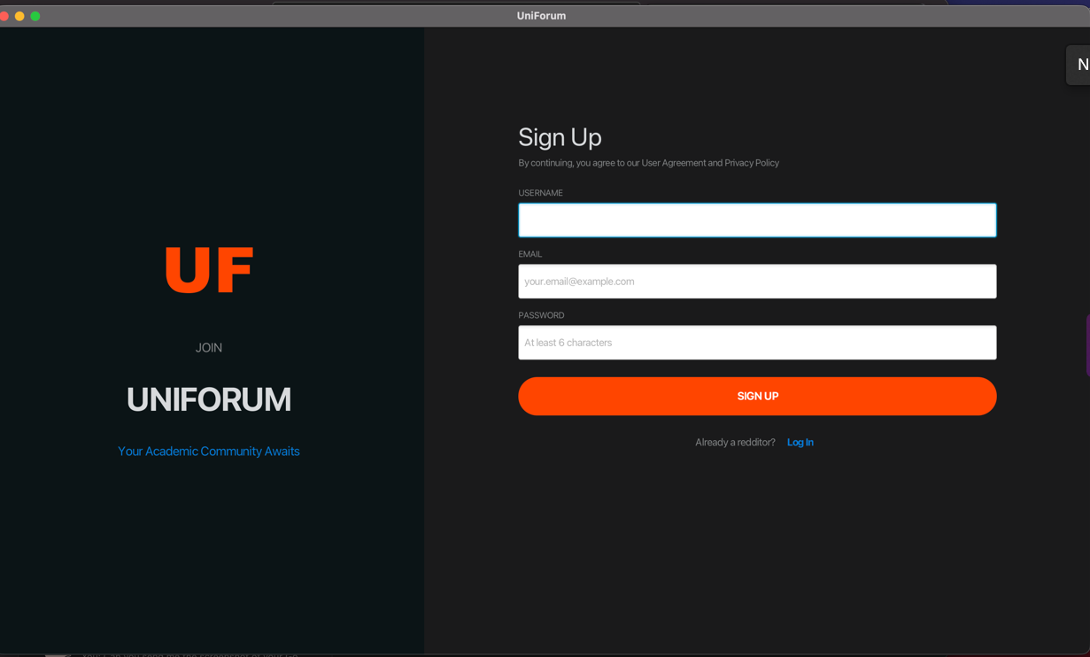
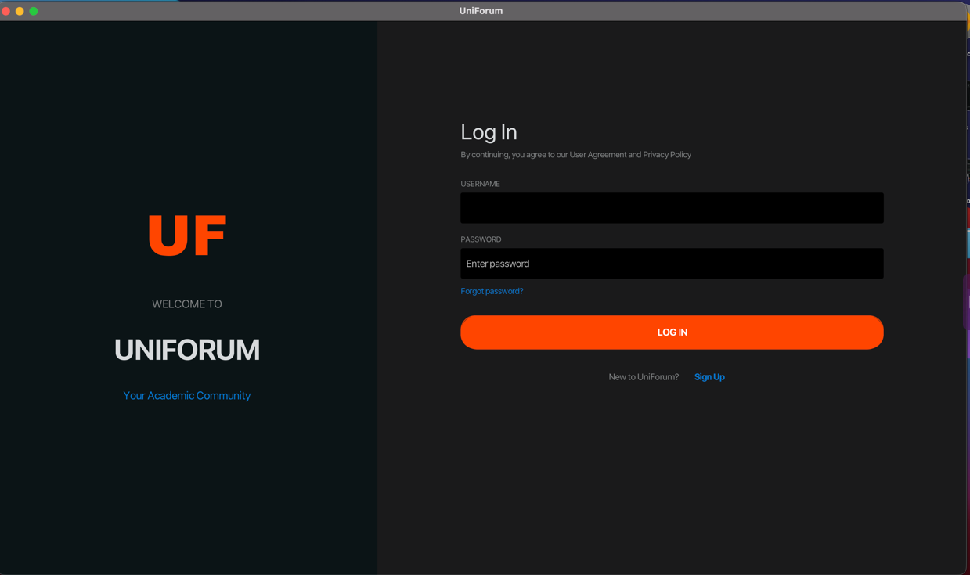
Results
SignUp / Login

Slide 11
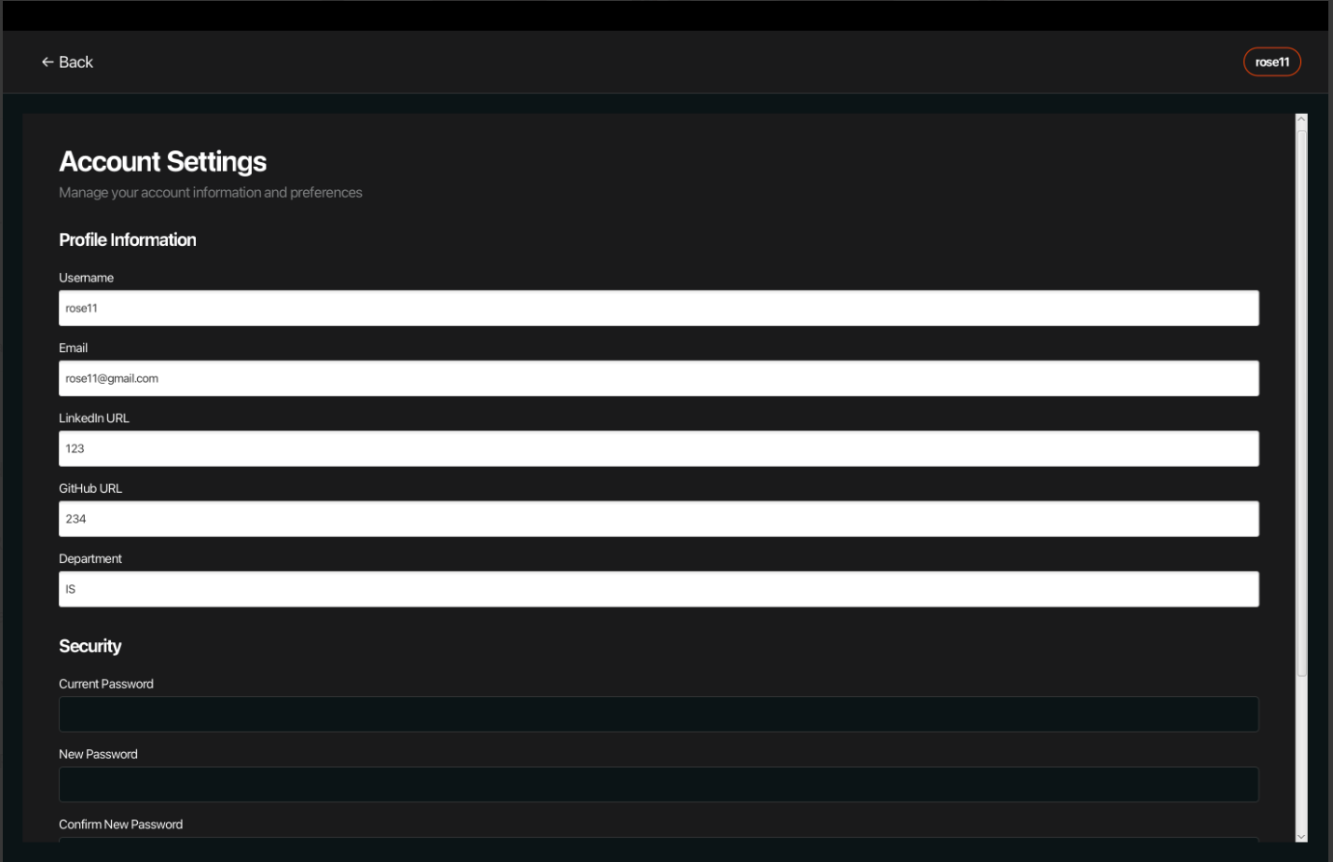
User Profile

Slide 12
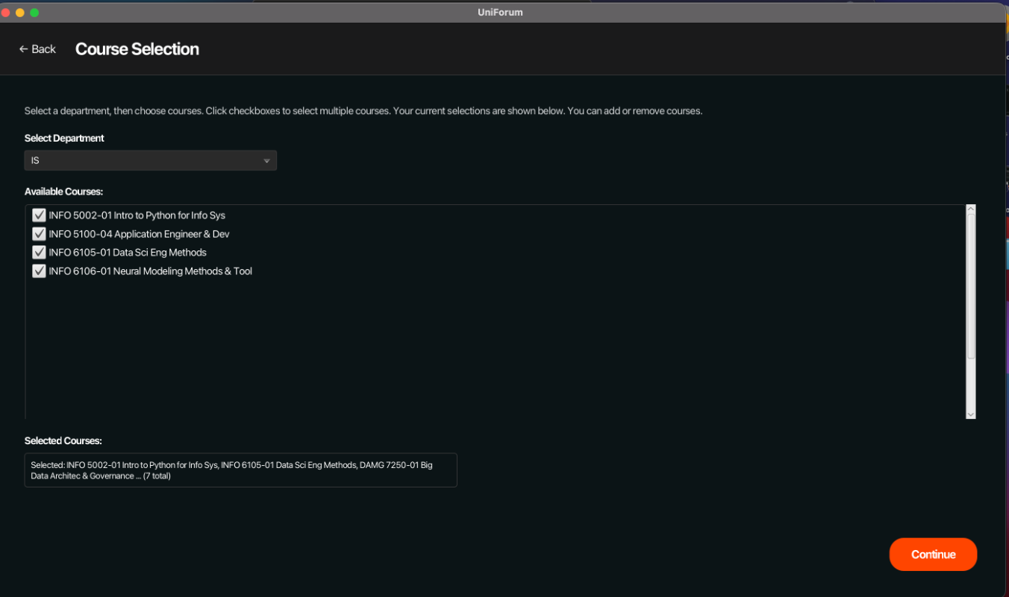
Course Selection

Slide 13
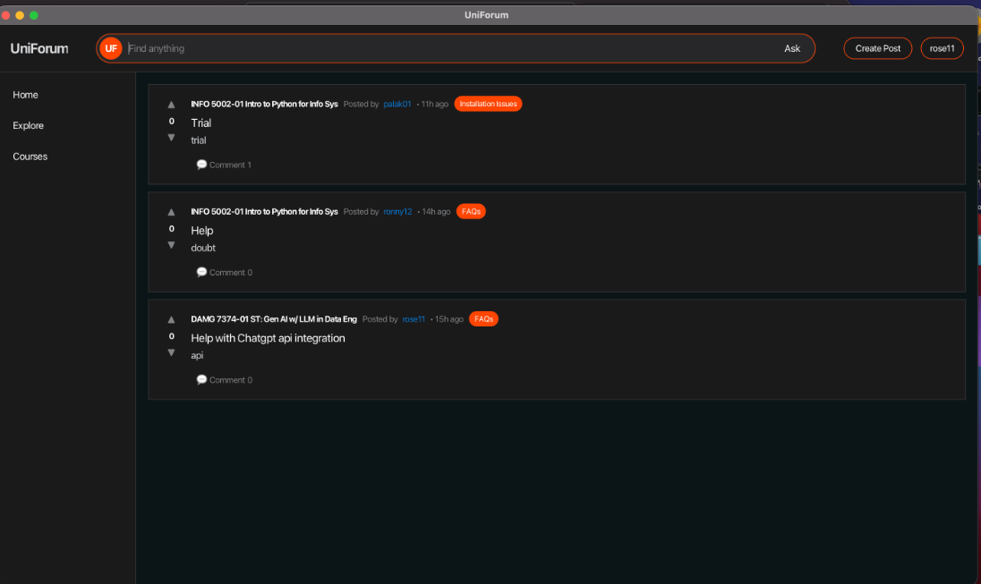
Forum Features

Slide 14
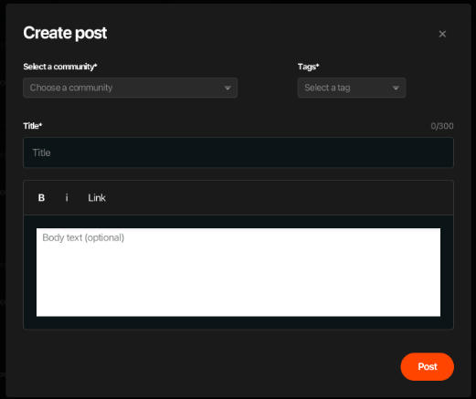
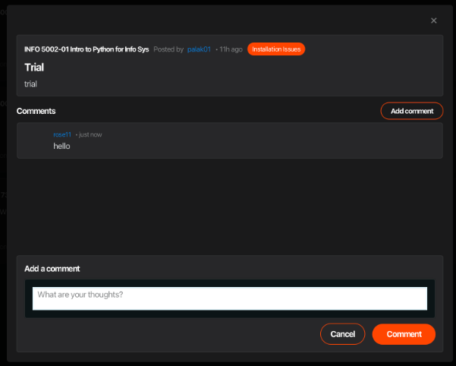
Creating Post & Comment

Slide 15
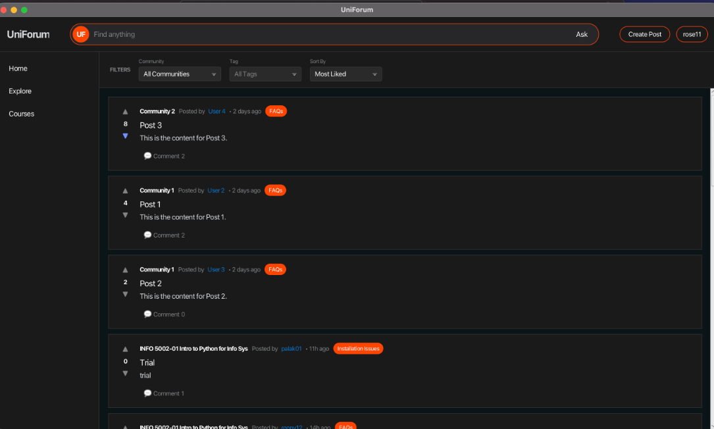
Forum Features

Slide 16
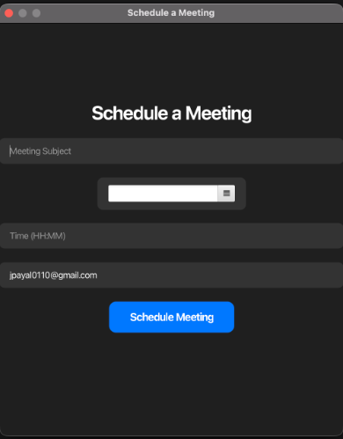
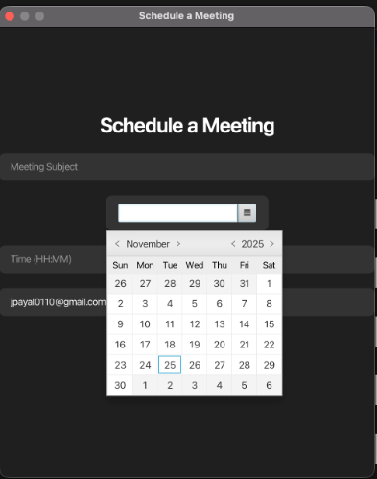
Scheduling Call - Gmeet

Slide 17

Run

Slide 18
Discussion
UI/UX learning — understanding how layout, clarity, and consistency impact student engagement
Team coordination — syncing modules, merging code, and aligning design decisions
JavaFX mastery — controllers, event handling, multi-scene flow, and database interaction
Real user needs — shaping features based on how students actually seek help
System design thinking — planning modules, data flow, and community structure
API integrations — exploring OAuth, Google Calendar, and scheduling concepts

Slide 19
Conclusions and Future Enhancements
•
Web Version: Migration to Spring Boot for browser access.
•
Mobile App: React Native or Android version for on-the-go access.
•
Real-time Updates: WebSocket implementation for live notifications.
•
Advanced Search: Elasticsearch integration for full-text content search.
•
Automatic community creation based on department (e.g., IS, SES, DAMG).

Slide 20






Team Contributions
Payal
Vimala
Vigneshwar
Forum Logic, Recursive Reply System, Upvoting, Searching logic, Create Post logic, Integration of all modules, Cosmetic Changes
Course module, Course Mapping, Meet Scheduling, API Integration.
User Authentication, Registration, Profile Management, DAO abstraction

Slide 21
Thank You

